Slide 1

Unsupervised Learning Algorithms
Agenda
Introduction to K-Means
k Nearest Neighbors intuition
Advantages & Disadvantages
Applications

Slide 2
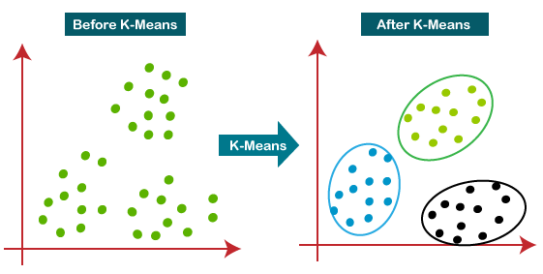
K-Nearest Neighbors (KNN) Algorithm
Definition: Clustering is the process of grouping similar data points together without labeled outputs.

Slide 3
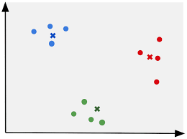
Initialize Cluster Centroids
Randomly place K cluster centers (centroids) in the data space.
These centroids act as the initial reference points for grouping.
Alternative initialization techniques:
K-Means++ (improves initial selection for better convergence).

Slide 4

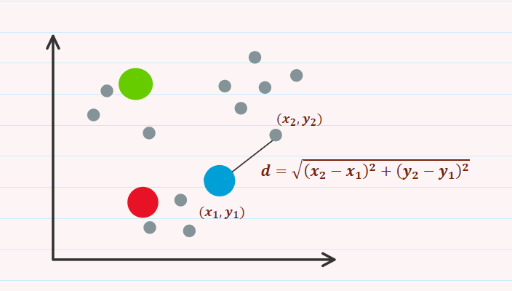
Assign Data Points to the Nearest Centroid
Each data point is assigned to the nearest centroid based on Euclidean distance.

Slide 5

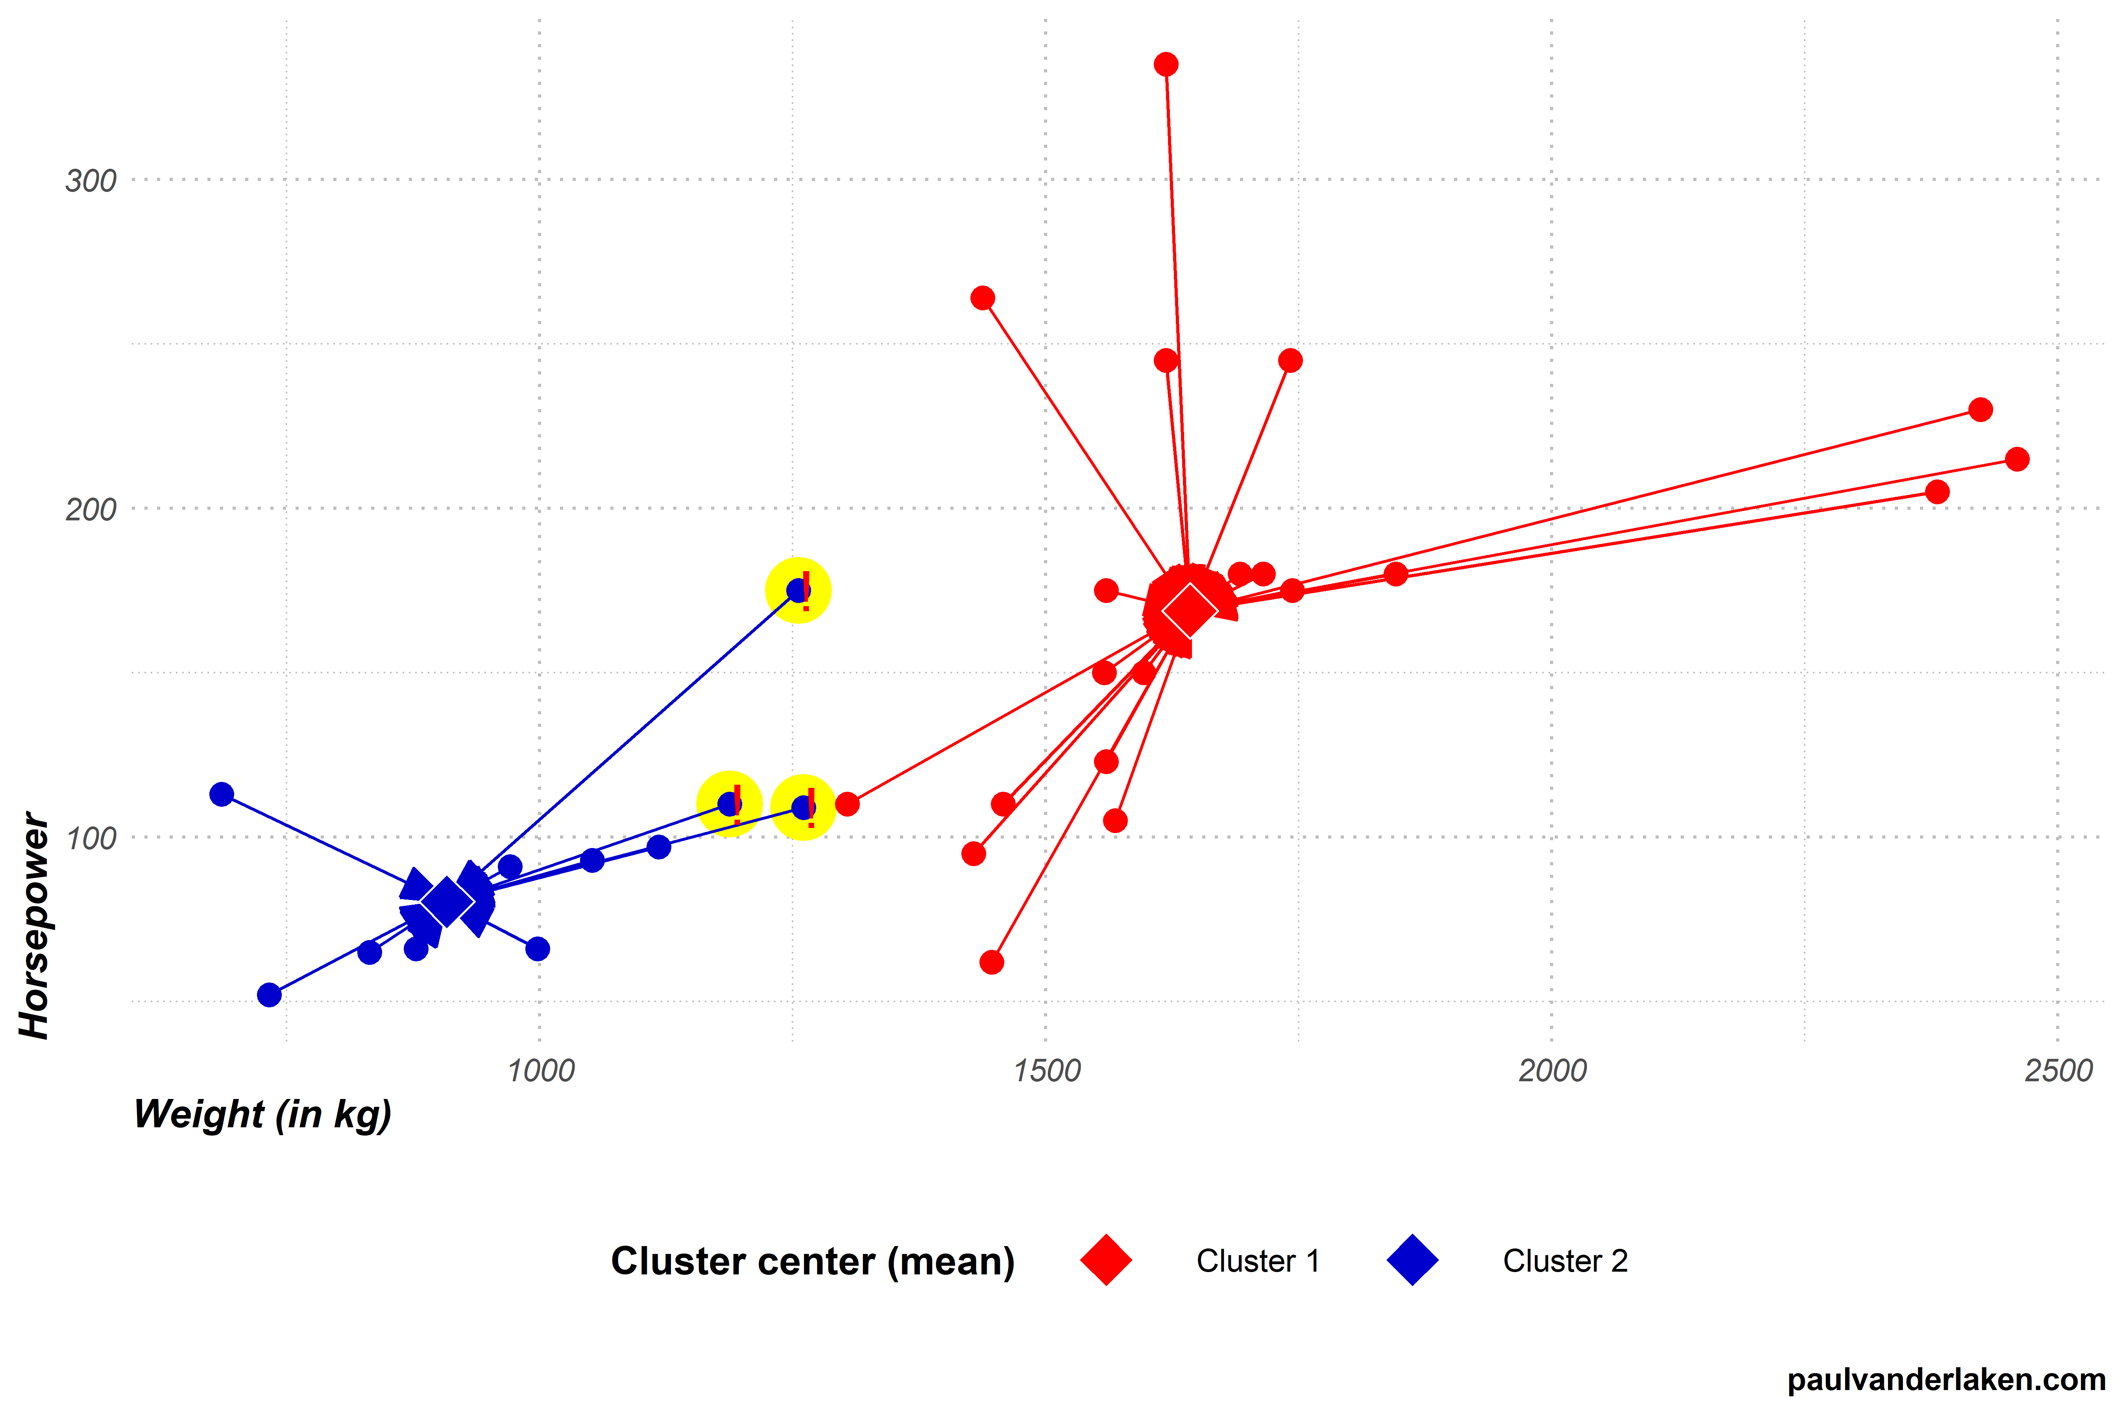
Update Centroids
The new centroid for each cluster is computed as the mean of all assigned points:
The centroid shifts to the new position, making the clusters more accurate.

Slide 6
Repeat Until Convergence
Steps 3 and 4 are repeated until centroids stop changing significantly.
The algorithm stops when:
Centroids no longer move.
A maximum number of iterations is reached.

Slide 7
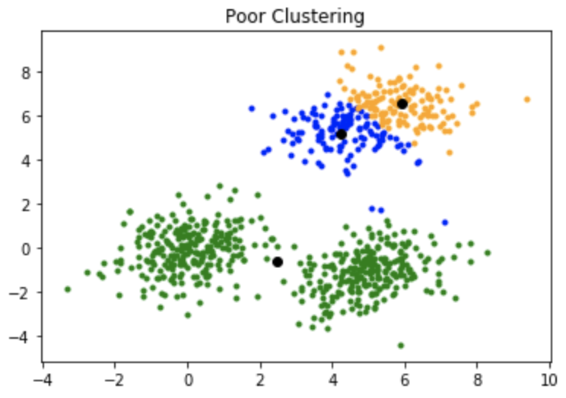
Choosing the Right Number of Clusters (K)
Selecting the optimal K value is crucial for effective clustering.
Too few clusters → Underfitting (loss of meaningful groups).
Too many clusters → Overfitting (unnecessary complexity).
Need a balance between interpretability and accuracy.

Slide 8
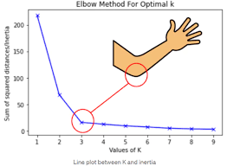

Elbow Method
Goal: Find the optimal K by minimizing within-cluster variance (WCSS).
Steps:
Run K-Means for different K values.
Plot K vs. WCSS (Within-Cluster Sum of Squares).
Identify the "elbow point", where WCSS stops decreasing significantly.
Formula for WCSS:
where ci​ is the centroid of cluster i, and xj​ are the data points.

Slide 9
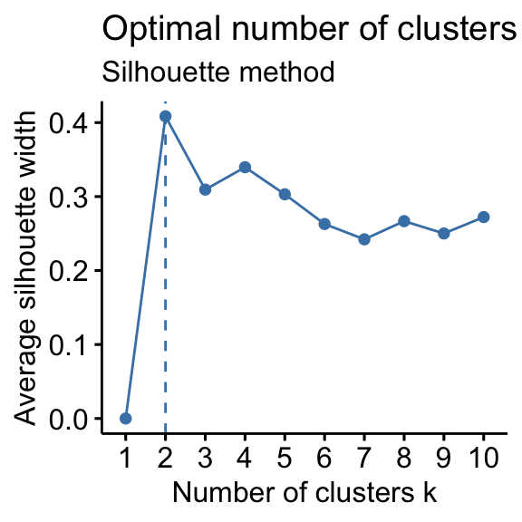

Choose the Number of Clusters (K)
Measures how well-separated the clusters are.
Score ranges from -1 to 1:
1 → Perfect clustering
0 → Overlapping clusters
-1 → Incorrect clustering
Formula for Silhouette Score:
where:
a = average intra-cluster distance
b = average nearest-cluster distance
Higher Silhouette Score → Better Clustering.

Slide 10
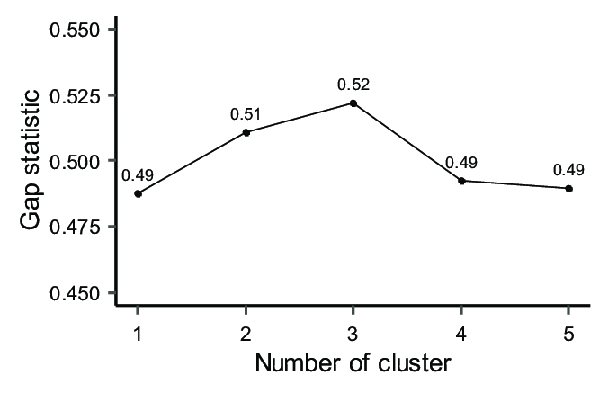
Gap Statistic
Compares within-cluster variance with a reference random distribution.
Steps:
Generate a random dataset of similar size.
Compute WCSS for both actual and random data.
Choose K where the gap between real and random WCSS is highest.

Slide 11
Advantages of K-Means Algorithm
✅ Simple and Fast
Easy to implement and computationally efficient.
Works well with large datasets.
✅ Scalability
Can handle millions of data points efficiently.
✅ Works Well with Numerical Data
Best suited for continuous features.
✅ Interpretable Results
Clusters are easy to visualize and understand.
✅ Efficient in High-Dimensional Data
Works well with multivariate data.

Slide 12
Limitations of K-Means Algorithm
❌ Choosing the Right K is Challenging
The performance highly depends on the correct selection of K.
❌ Sensitive to Outliers
Can be distorted by noise and extreme values.
❌ Assumes Spherical Clusters
Works best when clusters are circular and well-separated.
Fails if clusters are of different shapes or densities.
❌ Requires Normalized Data
Features must be scaled properly for best results.

Slide 13
Optimizing K-Means Performance
Best Practices for K-Means ✅ Feature Scaling: Normalize data using Min-Max Scaling or Standardization. ✅ Choose the Right K: Use Elbow Method or Silhouette Score. ✅ Remove Outliers: Apply Z-score filtering to detect and remove anomalies. ✅ Use Multiple Initializations: Run K-Means multiple times with different initial centroids. ✅ Consider PCA (Principal Component Analysis): Reduce dimensionality before clustering.

Slide 14
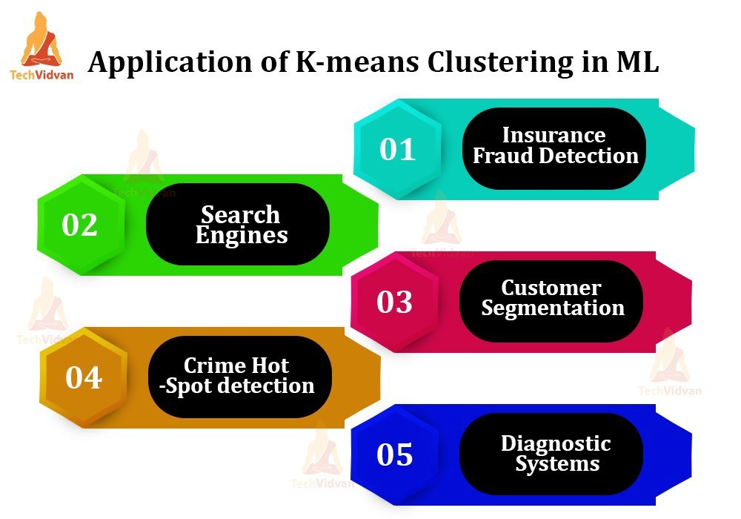
Real-World Applications of K-Means

Slide 15
K-Means vs. Other Clustering Algorithms
Feature | K-Means 🟢 | Hierarchical Clustering 🌲 | DBSCAN 🔴
Type | Centroid-based | Connectivity-based | Density-based
Speed | Fast ⚡ | Slow 🐌 | Medium 🚀
Handles Outliers? | No ❌ | Yes ✅ | Yes ✅
Handles Non-Spherical Clusters? | No ❌ | Yes ✅ | Yes ✅
Scalability | High 📈 | Low 📉 | Medium 📊
Memory Usage | Low 🔽 | High 🔼 | Medium 🟡

Slide 16
Thank You

